Slide 1
Desired Features
Ability to paste images into flash cards
Ability to select flash cards to look at from multiple different packs/topics/individual cards
Add, edit and delete packs/topics/flash cards
Algorithm that pushes cards to the back of the queue or near the front depending on if you got the answer right or wrong

Slide 2
Flash cards
Select cards
Modify data

Slide 3
Select packs/topics/cards
Computer Science Pack
  Topic 1: Programming Concepts
    Selection
    Sequence
    Iteration
  Topic 2: Databases
    Entity relationship diagrams
    SQL
    Primary, foreign, secondary keys
    Database normalization
Mathematics pack
  Topic 1: Logarithms
    Logarithm laws
    Natural logarithms
  Topic 2: Integration
    Integration by substitution
    Reverse chain rule
Done

Slide 4
What is the point of a primary key in a database?
Type answer here...
Submit

Slide 5
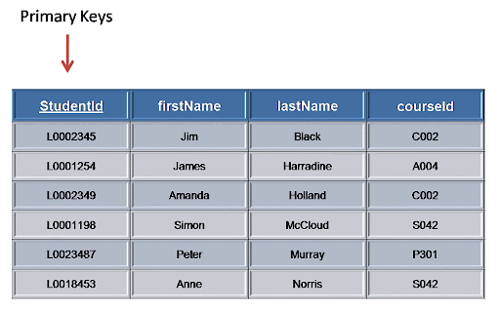
What is the point of a primary key in a database?
Uniquely identifies a record in a table
Used in composite keys to link tables together
I got it wrong
Your answer:
{previous_data_input}
I got it right

Slide 6
Incorrect answer
That flash card will be shown again to you within 3 turns
Return to main screen

Slide 7
Correct answer
That flash card will be pushed to the very back of the queue
Return to main screen

Slide 8
Modify data
Add data
Edit data
Delete data

Slide 9
Add data
New pack
New topic
New flash card

Slide 10
New pack
Enter pack name...
Submit

Slide 11
New topic
Select pack:
  Computer science
  Mathematics
Enter topic name...
Submit

Slide 12
New flash card
Select pack:
  Mathematics
  Computer science
Select topic:
  Programming concepts
  Databases
Next

Slide 13
New flash card
Enter question(s)… (new line gives new bullet point)
Enter any additional information...
Paste image (optional)
Next

Slide 14
New flash card
Enter answer(s)… (new line gives new bullet point)
Paste image (optional)
Submit

Slide 15
Edit data
Edit pack name
Edit topic name
Edit flash cards

Slide 16
Edit pack name
Select pack:
  Computer science
  Mathematics
Enter new name here...
Submit

Slide 17
Edit topic name
Select pack:
  Computer science
  Mathematics
Select topic:
  Programming concepts
  Databases
Enter new name here...
Submit

Slide 18
Edit flash cards
Select pack:
  Computer science
  Mathematics
Select topic:
  Programming concepts
  Databases
Select flash card:
  Database normalization
  Keys
  Entity relationship diagrams
Next

Slide 19
Edit flash card
Enter new question(s) here… (new line is a new bullet point)
Enter new additional info here
Paste image here to change the image
Next

Slide 20
Edit flash card
Enter new answer(s) here… (new line is a new bullet point)
Paste image here to change image
Submit

Slide 21
Delete data
Delete pack
Delete topic
Delete flash card

Slide 22
Delete pack
Select pack:
  Computer science
  Mathematics
Delete

Slide 23
Delete topic
Select pack:
  Computer science
  Mathematics
Select topic:
  Programming concepts
  Databases
Delete

Slide 24
Delete flash card
Select pack:
  Mathematics
  Computer science
Select topic:
  Logarithms
  Integration
Select flash card:
  Integration by parts
  Integration by substitution
Delete

